Slide 1
The QMR Process: Preparation and Documentation Tips for Local Systems and Practitioners
For This Webinar
QMR Word Scramble
Please Call: 866-842-5779
Enter Code: 463 661 9330#
ntnfai
rdorce
autid
ciedidma
lmopecncia
adotmcineount
yfamil
oinvtritnene
bnillgi
ivsti
Have Available
The printouts of the files emailed to you along with your login information.
Your phone will be muted. You will experience periods of silence until the webinar begins.
Notes:
Good afternoon, everyone. Thank you for joining today’s webinar. We will start in 1 minute.
<OK it’s 12pm, let’s get started>
Words: infant
record
audit
Medicaid
compliance
family
intervention
billing
visit
documentation

Slide 2




Welcome!
Dana
Mary Anne
Jeff
WORD SCRAMBLE ANSWERS
infant record audit Medicaid compliance
documentation family intervention billing visit
Notes:
Good morning! This is Dana Childress from Virginia’s Integrated Training Collaborative, and I am joined by Mary Anne White, Part C Monitoring Consultant, for today’s webinar on the Quality Management Review (or QMR) process and early intervention documentation. Jeff Beard from the Department of Medical Assistance Services also joins us to day to help with questions you may have as we go along.
Thank you for joining us today. We hope that, by the end of today’s webinar, you will have a better understanding of the QMR process and what to expect. We also hope to provide you with tips and key things to remember about contact note documentation requirements and best practices.

Slide 3

Housekeeping
Phones Are Muted
Chat for Communication
Notes:
Before we begin, let’s take care of a few housekeeping pointers. Lines will be muted during the call. To make comments and ask questions, you will be able to use your chat feature located to the right of your screen.

Slide 4
Practice Chat
Use Chat to Ask/Respond to Questions
Type message in box on (lower right corner)
Click into box, type message, press enter
Test Chat Now
Chat is Seen by EVERYONE!!
Notes:
To use the chat feature, click the mouse in the box in the lower right corner of your screen, type a message, and hit enter. Let’s try that now by saying “hi” to Mary Anne. As a reminder, anything you type in the chat box will be public and will be seen by everyone.
There will be opportunities throughout the webinar for you to respond to questions using your chat box. We’ll also try to respond to questions you post in the chat box as we go along. And finally, there will be time at the end of the webinar for questions as well.

Slide 5
Viewing Options
View Slides in Full Screen Mode
locate this button on bar below slides
click to view slides in full screen
Esc. Key to Return to Normal View
Notes:
Another feature you might want to take advantage of, is the ability to view these slides in full screen moce. They are best viewed in this format.
To go into full screen mode locate the button with 4 arrows on it. You can find it on the bar below this slide. When you’ve found the button, click it.
When you go into full screen mode you do lose the view of chat, but we will always guide you back to chat when necessary.
To get out of full screen mode, hit the escape key on your keyboard. Go ahead and try this now.
<pause>

Slide 6

Your Feedback
Complete a Survey
Notes:
Following this webinar, you’ll receive an email asking you to complete a brief survey to give us feedback. We ask that you please take a few moments and let us know about your experience participating in the webinar. This will help us as we develop future professional development opportunities.

Slide 7
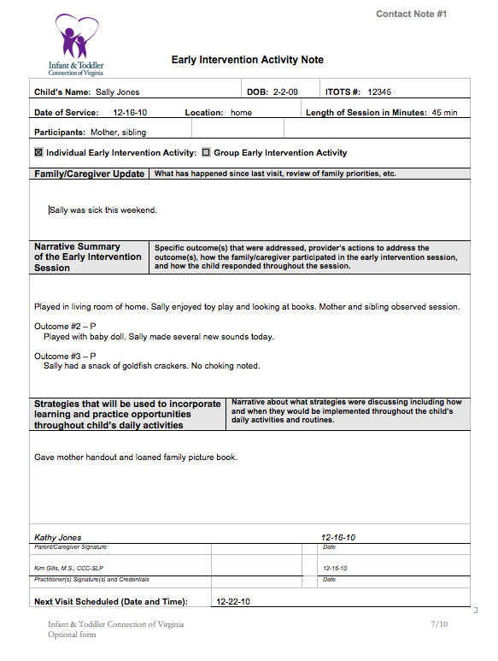
Handouts
DMAS EI Services QMR – Audit Tool
Contact Note Checklist
DMAS EI Services Report & Follow-Up Plan
Contact Note #1 – Sally Jones
Contact Note #2 – Sally Jones
Have Your Practice Manual Handy
Notes:
You should have received several handouts by email that you will need for this webinar. The handouts are listed on this slide. We will be reviewing and using these handouts during the webinar so please be sure you have them printed out. You will also need to have your Practice Manual handy.
I think we are ready to begin. I’m going to turn it over to Mary Anne to walk us through the QMR process.

Slide 8
Quality Management Review (QMR) Process
Preparing for the Process
Tips for Local Systems and Practitioners
Notes:
Thanks Dana. I am really pleased to be able to share with you information about the Quality Management Review or QMR process.

Slide 9

Purpose
Review the QMR process
Review general findings from the QMR pilots
Share documentation tips
Notes:
The purpose of today’s webinar is to review the QMR process that the Part C office will use with each local system. I will also provide an overview of a few general findings that were noted during the pilot process and talk about next steps.
The QMR process was piloted with three local systems. Modifications have been made to forms and processes based on the results of the pilot process. DMAS has been an active partner in the development of the processes as well as in the discussion of information gathered and reported during the pilot process. DMAS has indicated they feel this process meets appropriate state and federal requirements

Slide 10
Question
Why do you think we have
Quality Management Reviews or QMRs?
Use Chat to Respond
Notes:
Why do you think we have QMR’s? Use the chat to to respond. I will wait while you type in your responses. <watch timer and wait 30 seconds>

Slide 11

Why Do We Have QMRs?
Regulatory Requirements
    42 C. F. R. Parts 455 and 456
    12 VAC 30-50-131
    Virginia State Plan for Medical Assistance Services
System Transformation
DMAS Participation Agreement
Notes:
Federal regulations require that DMAS provide for continuing review and evaluation of the care and services paid through Medicaid, including review of utilization of the services by providers and by individuals. This is true for all Medicaid programs and is not a new requirement. What is new is that DBHDS, acting as an agent for DMAS, will be conducting the required QMR’s.

Slide 12
When and Where
Will QMRs Begin?
QMRs May Be
  Unannounced
  On-site Visit
  Desk Review
Notes:
There are several different ways QMR’s may be conducted. We are currently conducting announced, on-site visits. Unannounced visits or desk reviews could be conducted in the future.

Slide 13

Notes:
We will begin to visit local systems no later than April 1, 2011.
Each month, approximately 30 records will be reviewed. While, our intent is to review a sampling of records across all disciplines and provider agencies within a local system, DMAS may choose to select one provider agency (either public or private) in which the QMR is to be completed. The record selection process for the QMR will follow the same standards used in other audits performed by DMAS. In addition, the QMR team reserves the right to request additional records to be reviewed should the need arise.

Slide 14
What Happens During the QMR Process?
Pre-Site
Visit Activities
Post-Site Visit
Wrap-Up Activities
On-Site Visit
Three Components
Notes:
What Happens During the QMR Process? There are pre-site activities completed, the on-site visit and post on-site activities. Let’s take a look at each of these components.

Slide 15
Pre-Site Visit Activities
Purpose of activities is to prepare for on-site visit.
Notes:
In preparation for the on-site visit, DMAS, the Part C office AND the local system have activities to complete. Pre-onsite visit activities are designed to ensure that all necessary preparation is completed so the on-site visit is smooth and seamless.

Slide 16
Pre-Site Visit Activities
DMAS Will Select
  Local System
  Time Period
  Children
Notes:
DMAS is responsible for providing the Part C office with the name of the local system to receive an on-site visit, the names of children to be reviewed as well as billing received from the local system and paid through DMAS. This billing information includes, but is not limited to, the services provided, dates of service, billing code(s) used, agency providing the service and the amount paid for the services.

Slide 17
Pre-Site Visit Activities
Part C Office Will
  Notify Local System
  Obtain and/or Verify List of all Providers
Notes:
The Part C office is responsible for notifying the local system in writing, that they have been selected for a QMR. This notification will occur one-week prior to the date of the visit. The letter will provide the dates of the on-site visit, the list of records to be reviewed, and information about parent interviews. The one-week notice is provided to ensure that all required information is available during the on-site visit. The QMR team will not travel to provider agencies to gather and/or review information.
In the pre-onsite period, the Part C office will also verify provider licensure and EI certification status for the period covered by the QMR and review any additional information provided by DMAS.

Slide 18
Pre-Site Visit Activities
Local System
  Collect Records
  Secure Space
Notes:
The local system is responsible for ensuring that:
All requested information is gathered and available for the on-site visit. This would include the records selected for review, billing information, including billing in which Part C dollars were used to pay for any portion of services provided to the child.
In addition, a space where the QMR team will conduct the audit needs to be secured.
The local system also needs to ensure the QMR team can access electronic records and
An individual who has knowledge to address any questions that arise needs to be identified and available during the on-site visit.

Slide 19
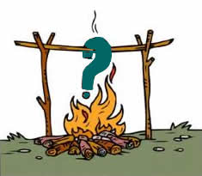
Your Burning Questions
Use Chat to Ask Your Question
Notes:
What is your most burning question about the on-site QMR visit?
I will wait while you type in your responses.
<watch timer and wait 30 second before responding>

Slide 20
Locate Documents
Please have these documents available for review:
  DMAS Early Intervention Services, Quality Management Review Form (QMR Audit Tool)
  Contact Note Checklist
Notes:
Please locate the 2 documents listed on your screen in front of you as we will be reviewing these documents. These documents were emailed to you with your login information with the guidance to print them for this webinar.
I’m going to pause for minute while you locate the documents.
<wait 1 minute>

Slide 21
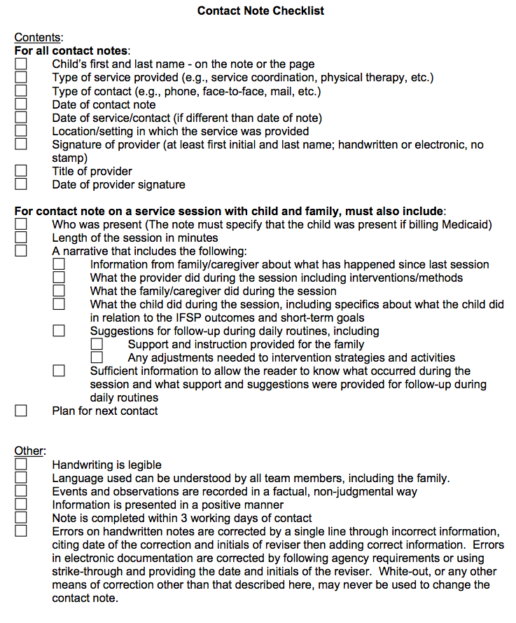
On-Site Visit
Documents
  DMAS Early Intervention Services, Quality Management Review Form (QMR Audit Tool)
  Contact Note Checklist
Team Leader
  Tamara Wilder
Notes:
The QMR Audit tool you have in front of you is the document currently used during the QMR process. If you have a copy of the QMR tool provided to LSM’s at the Leadership Academy earlier this year, please discard that copy.
The on-site visit will take place over several days. During the pilot process, we conducted the on-site visit in 2 days and had 4 team members present. At this point in time, we do not know how many members will be on the QMR teams. The number of team members available will be a factor in determining how many days the QMR process will take.
I’m pleased to let you know that Tamara Wilder will be the Team Leader for all future QMR’s conducted. She will be the individual you will be receiving information from and will answer questions you may have.

Slide 22

On-Site Visit: What Occurs
Record Review
Observation of Service Delivery
Review of Medicaid Billing Records
Notes:
At this time, we are completing the review of the child’s early intervention and billing records. We hope to be able to include observations in the future. Currently, the Part C office is in discussion with the Social Science Research Center at ODU about contracting with them to conduct the parent interviews. We piloted the parent interview process with 2 local systems during the pilot process. We will keep you posted on the outcome of our discussions with ODU.

Slide 23
Document Review
Pages 1-6 DMAS EI Services, QMR Document
Share one thing you did not realize would
be reviewed during the QMR process.
Use Chat to Share
Notes:
Take a look through pages 1 – 6 of QMR Audit tool. Please use the chat box and share one thing that you did not realize would be reviewed during the QMR process.
I’ll wait so you have time to type in your responses <watch timer and wait 1 minute>.

Slide 24
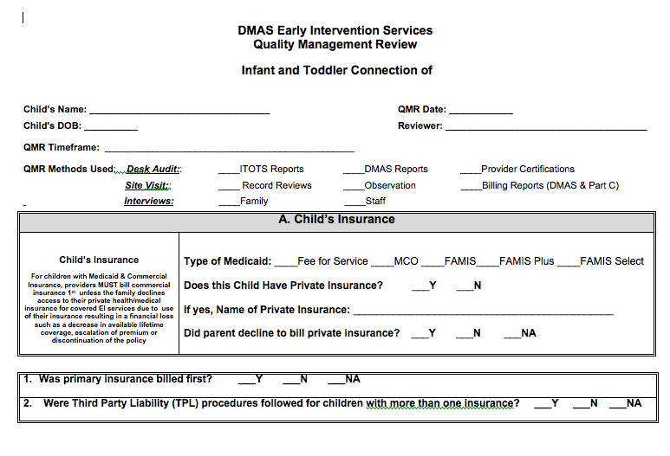
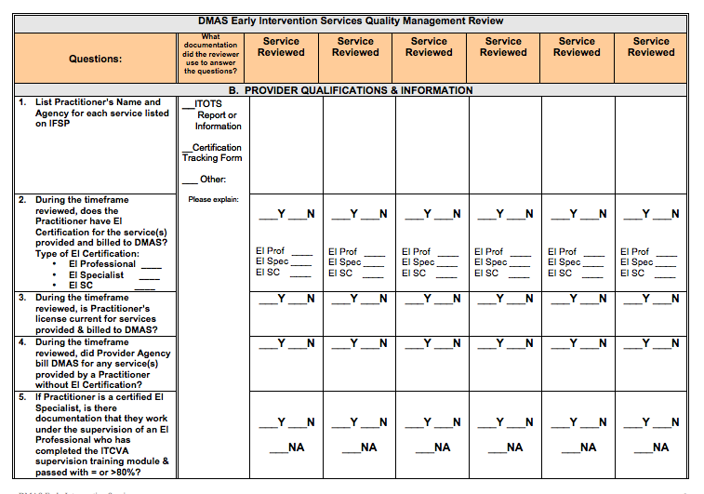
QMR Audit Tool
Notes:
The QMR Audit tool is broken out into different sections. We will be reviewing each of the sections so you have a better understanding of what information is looked at/for during the QMR process.

Slide 25
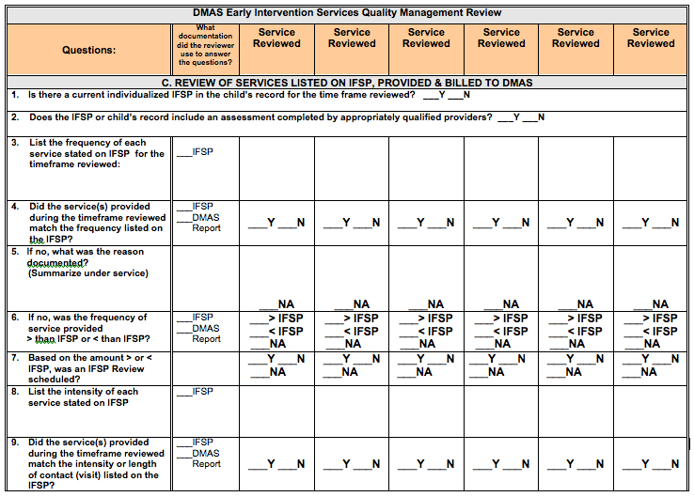
QMR Audit Tool: Page 3
Notes:
The QMR Teams completes as much of Page 1 and 2 of this document as possible during the pre-onsite activities.
Pages 3 and 4 of this document are focusing on the provision of services that are listed on the IFSP. An example of what we are looking at on these pages would be:.
The IFSP says a child is to have weekly Developmental services for 60 minutes. We will review the contact notes to determine:
is there a contact note for weekly visits, and if not, is there documentation indicating why a visit was not conducted;
Is 60 minutes documented on the contact note? If less than 60 minutes is documented on the contact note, is there a reason stated for why the service did not last 60 minutes?
We will then compare the time listed on the contact note to the billing information received from DMAS to see if they match. In addition, we will also verify that the billing code used to bill DMAS is the correct code for Developmental services; and
We will match the billing code for individual vs. group sessions against billing information received from DMAS.

Slide 26
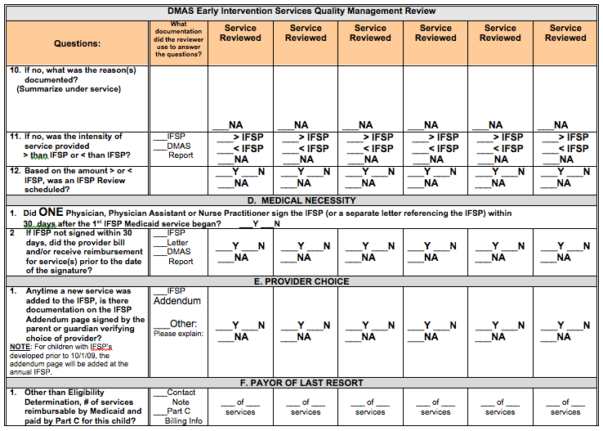
QMR Audit Tool: Page 4
Notes:
Page four of the Audit tool looks at three different areas. Regarding Medical Necessity, we will be looking for the ONE document authorizing the provision of all services and whether this authorization was obtained within 30 days following the date the first IFSP service.
Regarding provider choice, we will look at the IFSP Addendum Page that was in effect during the time period covered by the QMR to ensure that there is a parent signature demonstrating parents were provided with the opportunity to choose their providers each time a new service was added (at initial, periodic or annual IFSP).
Regarding the payor of last resort provision, we will review local billing records to determine if Part C dollars were used to pay for any services that could have been reimbursed through DMAS.

Slide 27
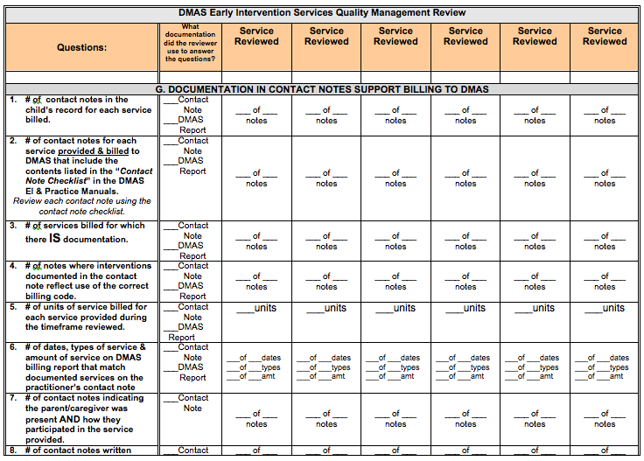
QMR Audit Tool: Page 5
Locate Contact Note Checklist
Notes:
Page 5 and 6 of the Audit is dedicated to documentation. In addition to completing this information, the QMR team completes a Contact Note Checklist for each service provided. Pull out your contact note checklist.
I’ll wait a minute for you to gather this document. <watch timer and wait 1 minute>

Slide 28
QMR Audit Tool: Page 5
Notes:
In general, we will be looking for a match between what is billed to Medicaid and what is documented in the child’s records such as dates of service, length of services, provider and location. We will also be reading each contact noted to determine whether there was sufficient information to inform what happened during the session, the child's response to the activities and HOW the parent/caregiver participated, More information about documentation will be shared in the second half of this webinar.

Slide 29
Question
Based on the information you just heard and saw regarding documentation, what areas do you feel you might need to improve on?
Use Chat to Respond
Notes:
I’ll give you a few moments to review the Chart Review Checklist. As you look at the document, think of areas that you feel you might be able to improve upon. Use the Chat box to share with others.
WAIT 30 seconds before responding

Slide 30
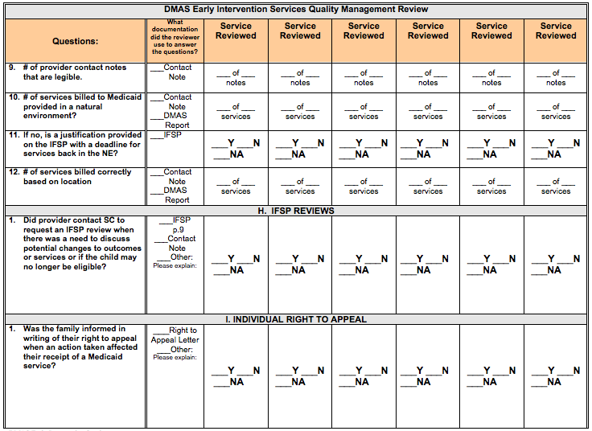
QMR Audit Tool: Page 6
Notes:
Page 6 of the Audit tool focus on IFSP reviews and the Individual Right to Appeal. The QMR team will be looking to see if an IFSP review was called to discuss whether there was a need to make changes to the IFSP; whether in the IFSP services listed or outcomes developed.
We will also look to see whether the “Early Intervention Services – Notice of Action” letter was provided to the family anytime there was a denial of a service, reduction in the frequency, intensity or duration of the service or whether the 30-day or 45-day timelines were not met for a system reason.

Slide 31
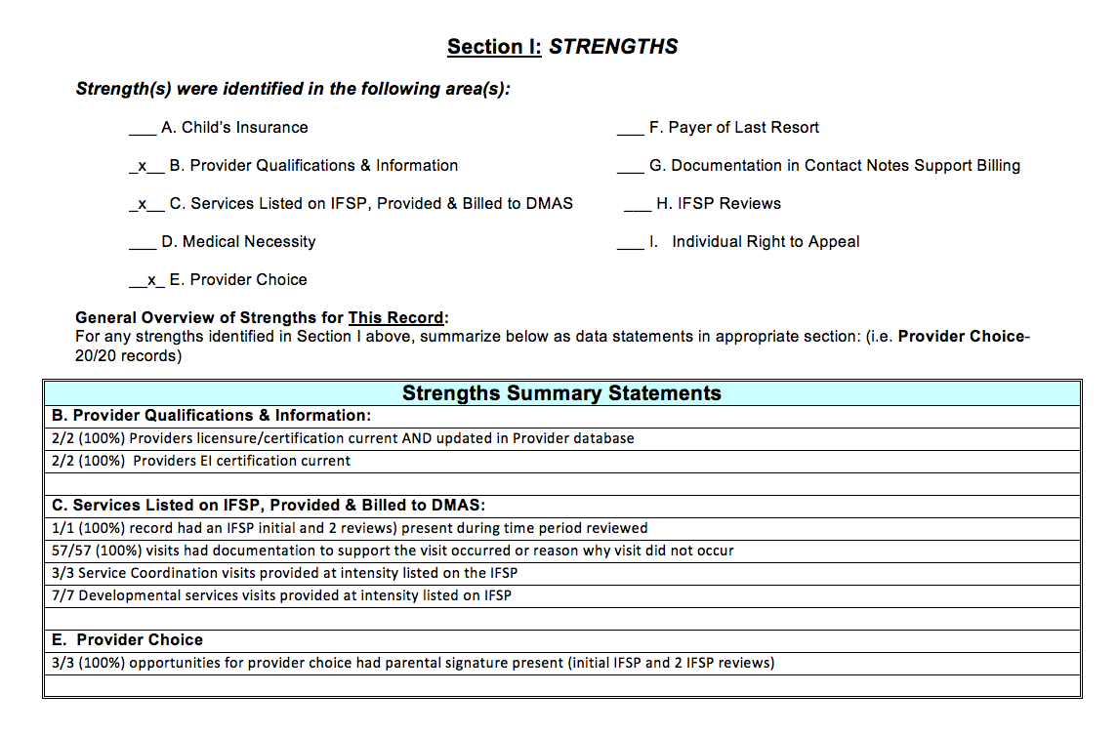
QMR Audit Tool: Pages 7/8
Notes:
Turn to Page 7 and 8 of the Audit Tool. PAUSE TO ALLOW for Turning of Pages
These two pages are designed for the QMR team member to summarize strengths noted in each of the sections of the Audit Tool. This form is completed on each record that is reviewed. All areas in which strengths are identified will contain appropriate information.
For each record reviewed, information from this page is synthesized in the “Overview of QMR Audit and Follow-up” report. We will review that shortly.

Slide 32
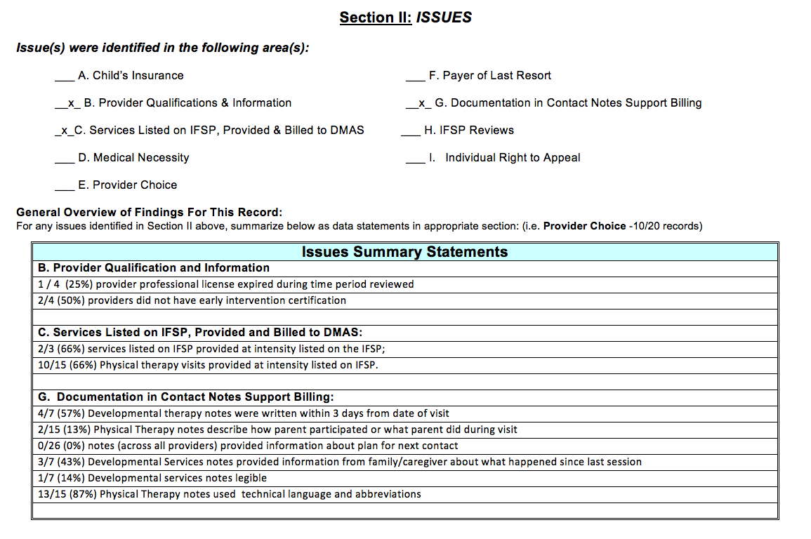
QMR Audit Tool: Pages 9/10
Notes:
Turn to Pages 9 and 10 of the Audit Tool PAUSE TO ALLOW TIME to FLIP Pages
These pages provide a summary of the issues noted in each section of the QMR Audit Tool. Again, this is completed on each child whose record was reviewed. Information is presented in the form of statements with percentages to show how frequently something did or did not occur.
Again, for all records reviewed, information from this page is synthesized in the QMR report.

Slide 33
On-Site Visit
Exit Interview
  General summary of strengths and issues
  Preliminary report to be sent for review
  Final report
Notes:
At the end of the visit, the QMR team meets with the LSM or designee to provide a general overview of the preliminary findings, both the strengths and issues identified. A preliminary report will be sent to the LSM for review with an opportunity to provide additional information related to the issues identified. Once the Team Leader receives a response from the LSM, a final report is written. This report is sent to the local system manager, with copies to DMAS, LSM Supervisor, Agency Director, Mary Ann Discenza as well as the TA and Monitoring consultants.

Slide 34
Post Site Visit Wrap Up
QMR Team Reconvenes
Team Leader Responsibilities
Notes:
Following the on-site visit, the QMR team reconvenes to summarize information gathered during the on-site visit. Areas of strengths and issues identified are discussed. The QMR team develops a list of questions/issues to review with DMAS and begins to identify topics or issues in which technical assistance and/or a Corrective Action Plan (CAP) is needed. Once all of this information is gathered, the Team Leader schedules a meeting with DMAS and drafts a preliminary findings report and follow-up plan.

Slide 35
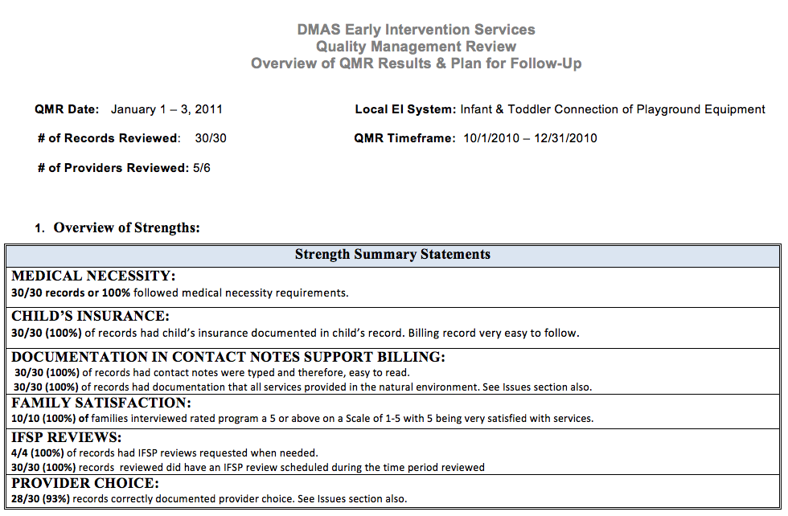
Notes:
Please get the document entitled “Overview of the QMR Results and Follow-Up Plan”. I’ll wait a minute while you get this document.
<watch time and wait 1 minute>
The image on the screen is an example of what you might find in the preliminary and final findings report. The information on the screen addresses strengths noted during the QMR audit. As you can see, information will be provided as statements. These statements are reflective of the accumulation of data gathered from all records reviewed.

Slide 36
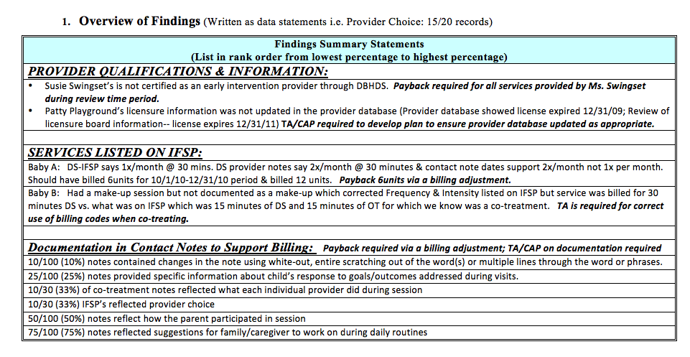
Notes:
The image on this screen provides on overview of the findings or issues noted during the QMR process. Information provided may be child specific or general in nature. Information provided will contain whether TA, CAP and/or a payback to DMAS is necessary.

Slide 37
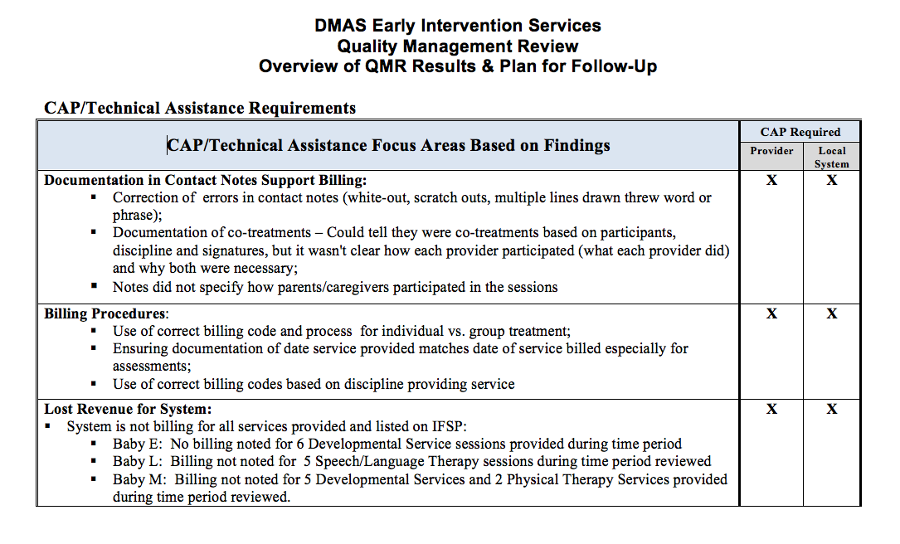
Notes:
The information you see on the screen provides an example of what might be required for TA and/or CAP. The Local System Manager, TA and Monitoring Consultants will work collaboratively to ensure implementation of both the CAP and activities to address technical assistance needs

Slide 38
What Did We Find During the Pilot QMRs?
Strengths
  75/76 providers were EI certified
  Services provided in the natural environment
  Documentation of medical necessity
  Documentation of provider choice
  Documentation was present for most services provided
  Parents were satisfied with services received
Notes:
You have just completed a “walk through” the QMR process. As you can see, this process is a collaborative effort on the part of DMAS, the local early intervention system and the Part C office. I’d like to share with you some general findings we noted during the pilot process. Before doing this, I would like to thank our three pilot sites for their willingness to work with us as we implemented this process.
There were many strengths noted within each local system that participated in the pilot process. Listed here are just a few of the over arching strengths noted. We found all but one provider was certified by DBHDS as an early intervention provider. We also noted that all services reviewed were provided in a child’s natural environment. There was sufficient documentation of medical necessity and provider choice. The parents interviewed had many positive things to say including how happy they were with the early intervention system and the providers who worked with their children.

Slide 39
What Did We Find During the Pilot QMRs?
Issues
  Billing
  Documentation
  Provision of services in accordance with the IFSP
Not all services provided were billed to DMAS
Notes:
A few of the overarching issues noted during the QMR process were centered around billing, documentation and the provision of services in accordance with the IFSP. As you have heard both Brian Campbell and Jeff Beard say, we did find services that were provided and not billed to DMAS.
Regarding billing, we noted that in some cases, when a child had both Medicaid and third party insurance, the third party insurance company was not always billed before Medicaid. Remember that you must provide documentation that the third party insurance company denied payment before Medicaid will reimburse for services. We also noted that the appropriate billing codes were not always used when co-treatment was provided to a child. Please review Chapter 11 of the Practice Manual and/or contact your TA for assistance if you feel this is an issue with your local system.
We noted that the majority of issues identified during the QMR audit were around documentation. Documentation will be discussed in depth in the next part of the presentation.
There were issues noted regarding the frequency, intensity and duration of services provided and how this compared to what was listed on the IFSP and billed to DMAS. Please be sure that your documentation reflects what was provided and if that is not in accordance with the IFSP, provide an explanation for the difference.
I hope you have found this walk-through of the QMR process helpful and have a better idea of what will occur when you are selected for a QMR audit. The Part C office is available to answer any questions as you go through the QMR process. Dana is now going to talk to you about documentation tips. Dana….

Slide 40

So What Can You Do?
Notes:
Thank you, Mary Anne. So, what can you do as a local system or as an individual to get prepared for the review process? A great place to start is by looking at your documentation and considering your own strengths and areas for improvement.
We’re now going to talk about tips and strategies for good documentation in the early intervention record. These tips are based on the pilot review results and on feedback from the monitoring staff.

Slide 41
Question
In addition to the QMR process, what are some other reasons why thorough documentation is so important?
Use Chat to Respond
Notes:
We know that thorough documentation is vitally important to the QMR process, but it’s also important for a variety of other reasons.
What are some other reasons why completing thorough documentation is so important? Share your answers by typing them into the chat box.
<Watch Timer and WAIT 30 seconds>
IDEAS – In case of a substitute provider
So families have documentation of the intervention they have received
In case the file is subpoenaed to court
To monitor progress

Slide 42

Purpose of Documentation
Clearly capture what happened during an interaction with or on behalf of a family.
Notes:
Ensuring that your documentation meets requirements and is thorough is a critical part of providing EI supports and services. Good documentation does not have to take a long time to complete, but does require attention to detail and a clear understanding of the purpose of documentation – to clearly capture what happened during an interaction with or on behalf of a family.

Slide 43
Notes:
Documentation in a child’s early intervention record should paint a very clear picture of what occurred during the intervention visit or during the communication with the family (if by phone or other means) so that others reading the note will know what you did, what the parent did, and what the child did during that visit or communication.

Slide 44

Ask Yourself
Would someone else be able to read my contact note and understand what occurred during my visit/communication with the family?
Notes:
When you’re documenting contacts with families and others, you can ask yourself: Would someone else – the service coordinator, another provider, the child’s parent, the child’s insurance provider, the Part C office - be able to read my note and understand what occurred during my visit or communication with the family? This also holds true when documenting contacts between service providers or other agencies on behalf of the child and family.

Slide 45
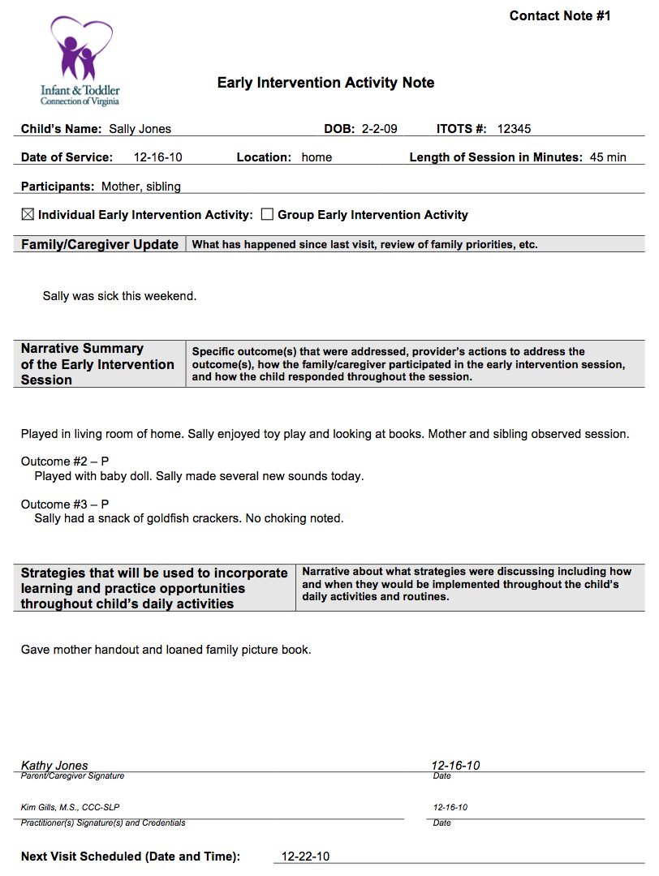
Locate Contact Note 1
Questions to Consider
What questions do you have about this intervention visit?
What information is missing?
Notes:
Let’s look at two contact notes to help us think about how notes might be written considering the question we just asked ourselves.
Please find the Early Intervention Activity Note for Sally Jones that is labeled as “Contact Note #1” in the upper right corner of the page. You can either use the handout you printed out or expand your screen in full screen mode to view the contact note on your screen.
Once you’ve located it, read it and think about what questions you would have if you were this family’s service coordinator or a substitute service provider who was planning a visit with the family.
We will pause for 1 minute to give you time to locate and read the note. There will be silence on the line while we pause.
<watch the timer and wait 1minute>

Slide 46
Contact Note 1
What questions do you have about this intervention visit?
What information is missing?
Use Chat to Respond
Notes:
Please use the chat tool to share your questions about this intervention visit and to comment on what information is missing.
I’ll wait while you type into chat.
<watch time and wait 30 seconds before responding>

Slide 47
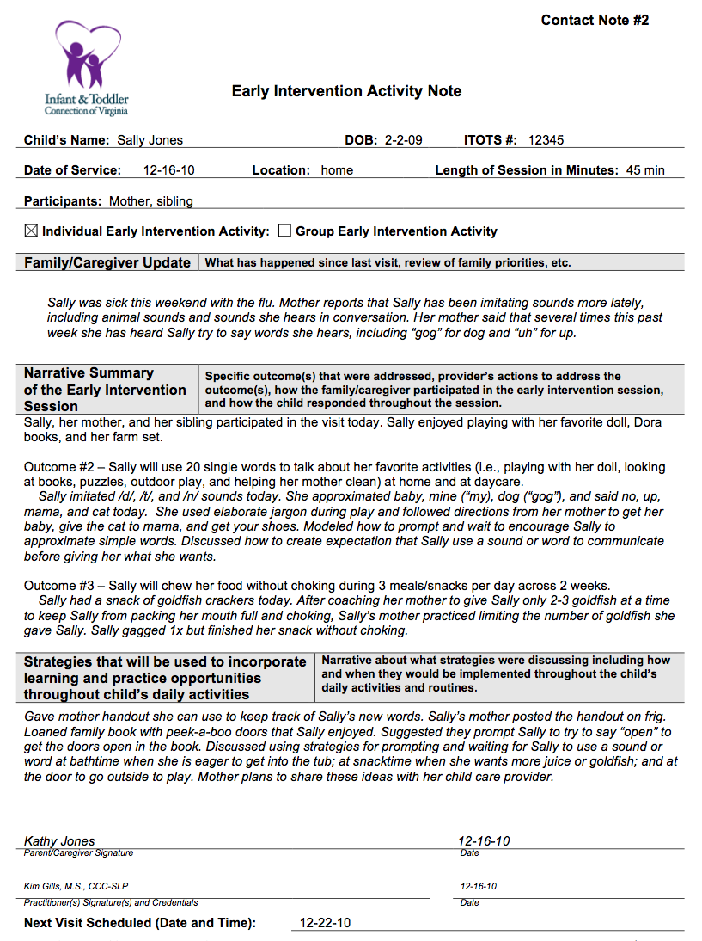
Locate Contact Note 2
Questions to Consider
What differences do you see between Contact Notes 1 and 2?
Do you know what happened on this visit?
Notes:
Now let’s look at a note for the same visit that is fleshed out with more detail. Find your other activity note for Sally Jones that is labeled “Contact Note #2” in the upper right corner of the page, or again, you can view the note in full screen mode here. Compare the two notes and answer the questions: What differences do you see? Do you know what happened on this visit?
Again, we’ll pause for 1 minute so that you can read the note.
<watch timer and wait 1 minutes>

Slide 48
Contact Note 2
What differences do you see between Contact Notes 1 and 2?
Do you know what happened on this visit?
Use Chat to Respond
Notes:
Please share your answers to these questions using the chat box.
<wait 30 seconds before responding>
A main difference you’ll notice is that Contact Note #2 is a more wordy note. These additional words provide a rich description of what was observed and practiced during the visit, in contrast to the more general information provided on Contact Note #1. Again, writing your note to capture what occurred during the visit does not have to result in a long note or one that takes a long time to write. Contact notes can be brief, as long as they specifically describe the activities of visit.

Slide 49
Notes:
To help you ensure that your documentation meets requirements and is complete, let’s review the Contact Note Checklist. As a reminder, this checklist is also available in your Practice Manual on page 140. I’ll give you a moment to find the checklist again.
<watch timer and wait 30 seconds>
Some items on the checklist are more intuitive than others, like including the child’s name, but all are equally important.
Let’s highlight a few items on the checklist that were noted to be missing in notes that were reviewed during the QMR pilots:

Slide 50
Notes:
Be sure to indicate the Type of Contact you have with the family, whether by phone, mail, or face-to-face.

Slide 51
Notes:
Including the Date of the contact helps the reviewer (and the local system manager) know whether services are being provided as indicated on the IFSP. The date of contact also needs to match when comparing to services billed.

Slide 52
Notes:
The Service Provider’s Signature is required by payors and must include at a minimum the service provider’s first and last name.

Slide 53
Notes:
A contact note should describe Who was present for the visit. If the child’s service will be billed to Medicaid, then the contact note should specify that the child was present during the visit.

Slide 54
Notes:
The Narrative of the contact note should address what the family reports has happened since the last visit as well as what occurred during the visit. Information about what the provider, family members, and child did during the visit as well as suggestions for follow-up activities during daily routines between visits must also be included

Slide 55
Notes:
Finally, you want to be sure to use Language that can be understood by everyone including the family and other team members. During the pilot reviews, considerable use of technical jargon and abbreviations that appeared unique to the service provider was noted. You should try to avoid using technical jargon and abbreviations unless these will be easily understood by a variety of readers.

Slide 56

Documentation Tips
Contact Notes
Notes must be descriptive
Be objective and positive
Indicate what outcomes & goals were addressed
Notes:
Now let’s talk about some specific tips we would like to share with you to help you prepare for the QMR process. These are just a few tips based on what was learned from the pilot reviews.
For your contact notes, also remember to:
Be sure notes are descriptive of who did what, how, when, and why
Use objective, positive statements when describing the activities and discussions that occurred during the visit.
Note which outcomes and goals were addressed during the visit. Many local system have outcomes and short term goals pre-printed on their contact notes. Remember that if you don’t address an outcome or goal that is listed on your contact note, you must mark n/a by it rather than leave it blank.

Slide 57
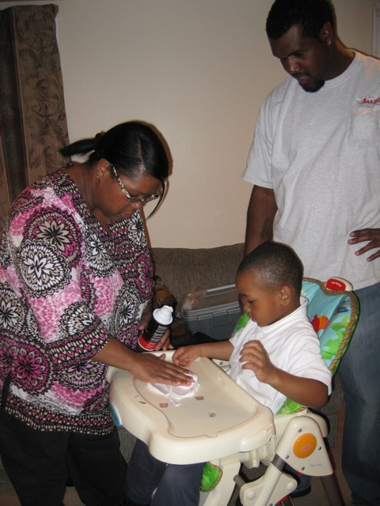
Documentation Tips
Be Specific
Provide information about how the parent/caregiver participated during visit
Include the child’s activities and responses in specific terms
Avoid general statements such as “progressing”
Notes:
While most notes in the pilot reviews indicated that a parent/caregiver was present during the session, the notes did not always provide information about what the parent/caregiver did or how they participated in the session. Use the narrative section of the contact note to provide sufficient to allow a reader to know what occurred during the session. (As you all noted, the first note for Sally Jones was missing most all of this information.)
You also want to be sure to specifically describe what the child did during the visit. During the pilot reviews, the reviewers found that information about how the child responded to activities addressed during the session varied. The information provided must be sufficient for a reader to know what the child did in response to the activity. This would mean including information such as the number of times something occurred, the words heard during the session, the number of seconds/minutes a child was able to maintain a position. Only indicating that the child is “progressing,” or writing general statements such as “we looked at books” or “the child sat independently” does not provide a complete picture of the child’s response to what occurred during the session.

Slide 58
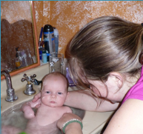
Documentation Tips
Describe
How family activities & routines were incorporated
How you coached the family
Strategies parent will try between visits
Notes:
Contact notes for supports and services should describe how family activities and routines were incorporated into the visit. Describing the activities and routines that were incorporated should provide the reader with the context for the visit.
Be sure to include a description of how you coached the family in the use of intervention strategies during family routines.
You’ll also want to describe what strategies you and the parent collaborated on and what plans you developed together for how the parent will use strategies between visits.

Slide 59

Documentation Tips
EI Record
  Include clear documentation of
  Provider Choice
  Medical Necessity
  Payor of Last Resort
Notes:
In terms of the EI record, Mary Anne has already mentioned the importance of ensuring that documentation addressing Provider Choice, Medical Necessity, and Payor of Last Resort are included.

Slide 60
Documentation Tips
EI Record
File email exchanges
Document Individual Right to Appeal when applicable
Notes:
If a family wishes to communicate by email, be sure to check with your agency as this method of communication is not secure and may not be permitted by some agencies. If it is, be sure to document email exchanges in your contact notes and print and file the emails.
For families with Medicaid, be sure to document that they were provided with their Individual Right to Appeal letter when applicable.

Slide 61
A Few More Strategies
Practice Manual – Ch 9
Seek out critiques
Put your own monitoring processes in place
When in doubt, more detail is always better!
Notes:
We have a few more general strategies to share with you to help you prepare for the QMR process:
Remember the resource you have in the Practice Manual. When you have questions about documentation, a great first place to look is in the Practice Manual. There is guidance throughout the manual related to documentation, and Chapter 9 focuses on the EI record specifically.
It is always a good idea to have another pair of eyes look at your work, so ask others to critique your documentation and give you feedback.
Build your own monitoring system to keep an eye on documentation and service provision in your locality or program. For example, supervisors and local system managers should be conducting regular team reviews of records to monitor documentation and services. When these in-house reviews are conducted, it is very important to give staff constructive feedback so that they know what they are doing well and where improvements are needed. Some local systems do voluntary billing retractions when they find internal errors. This way they identify and correct issues with billable services before a real audit occurs.
We encourage you to identify your own strengths and areas where improvement is needed BEFORE QMR so that you can prepare and know what to expect.
Finally, when in doubt, provide more detail rather than less in your documentation. Remember that others should be able to read your documentation and clearly know what occurred!

Slide 62

We’re In This Together!
Notes:
As we prepare to wrap up the webinar and take your questions, we want to remind you of two important points related to documentation:
First, remember the saying “if it’s not documented it didn’t happen.” Be sure that you are documenting any and all contacts with or on behalf of families.
And second, how you document the specifics of your visits with families affects local system compliance, which in turn affects the state’s compliance.
Remember that we are all in this together!
Each of you has an important part to play in the QMR process. We encourage you to take the time to re-examine your own documentation and be sure you are capturing all of the incredible things you do with the families you serve everyday.

Slide 63
?
Use Chat to Ask
Notes:
We hope that this webinar has provided you with useful information to help you prepare for the QMR process and improve your documentation. If you have any other questions about the QMR process or documentation, please feel free to ask them now using your chat box. We will pause on this slide to take your questions.
Thank you for your great questions. We also want you to know that the monitoring staff will be reviewing your questions and will be developing a Q&A document about the QMR process. An email will be sent out as soon as this becomes available. If you would like to get in touch with any of the three pilot QMR sites, please let Mary Anne know.

Slide 64
Thank You QMR Pilot Sites
Infant & Toddler Connection of Fairfax - Falls Church
LSM: Allan Phillips
(703) 246-7307
allan.phillips@fairfaxcounty.gov
Infant & Toddler Connection of Hanover
LSM: Karen Walker
(804) 723-7020
kwalker@hanover.k12.va.us
Infant & Toddler Connection of Virginia Beach
LSM: Jennifer McElwee
(757) 385-4425
jmcelwee@vbgov.com
Notes:
We would like to thank the three local systems that volunteered to participate in the QMR pilot reviews: The Infant and Toddler Connections of Fairfax, Hanover, and Virginia Beach. The local system managers of these sites have also agreed to be available for questions, so please feel free to contact them.

Slide 65

www.eipd.vcu.edu
Thank You
a recording will be available on our website in approximately 10 days
Virginia Early Intervention
Professional Development Center
Notes:
Again, thank you for joining us for today’s webinar. You will be receiving your survey following the webinar and we welcome your feedback and suggestions.
Please let you colleagues who couldn’t join us today know that this webinar will be archived within the next few weeks and will be available on the Virginia Early Intervention Professional Development Center website: www.eipd.vcu.edu
Happy New Year to you all and have a wonderful day!

